Slide 1

StackOverflow – Tag Classification
Piyush Aggarwal

Slide 2
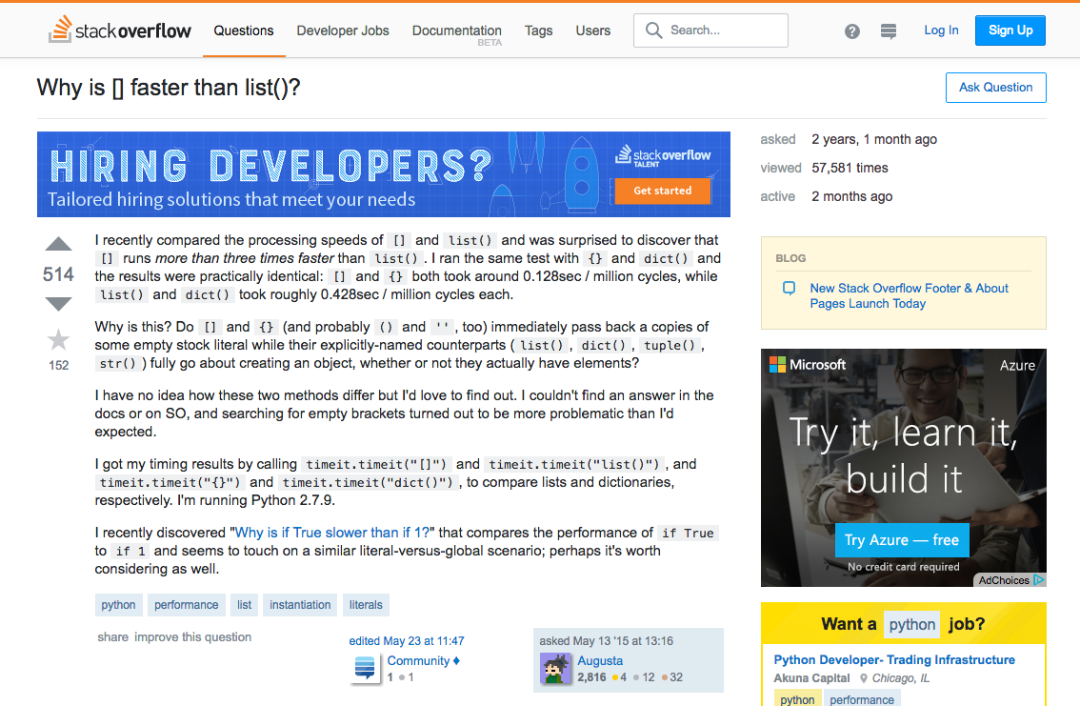


Problem and Challenge:
Every document is a mixture of topics
Every topic is a mixture of words
Millions of questions posted without any moderation
Every user has an open-ended way of posting a question – own syntax and semantics
Hard to identify which words contribute the most to which topics
Hard to classify tags that are most relevant to a question posted
Main attributes
Upvotes & Downvotes
Tags – for eg: Python, C#, etc. associated to a question

Slide 3



Success Criteria:
Classification of questions with the most popular tags (top 10 tags) used across organizations
We take our ‘Be Nice, Be respectful’ policy seriously
Identify questions & provide learning bootcamps with a rich library of articles around top 10 tags/technologies/ languages to developer associates

Slide 4










Steps Involved:
Data Wrangling
Exploratory Data Analysis
Feature Engineering
Modeling and prediction
Model 1 Model 2 … Model 6
Questions with top 10 tags only
(182K questions)
Multi-label Classification
Data
Merged dataframe: ~2014K Stackoverflow questions
Cleaned Data
Combined dataset: 1455K questions
Data (Training data development)
Training: ~127K questions
Test: ~54K questions

Slide 5
1. Data Wrangling
https://github.com/piyush-springboard/projects-and-assignments/blob/main/Capstone-3/Data%20Wrangling%20and%20Exploratory%20Data%20Analysis.ipynb
Steps Involved
Merge training and test data set
Total question entries – 2014K
Missing data manipulation and null handling
Converting all letters to lower or upper case
Removing html tags, punctuations, stop words, sparse terms
Stemming using NLTK library
Removing white spaces, newline characters, entries with very long words (likely junk values) and with small text length
Original dataset had 2 .csv files and word embeddings.
This step includes text data preprocessing.
Raw data – ~2014 questions
Only csv data is used for this project
Question body
Dependent Variable
Independent Variable
5 columns indicating top 5 tags present or not (1 vs 0)
Cleansed data - ~1455K questions

Slide 6
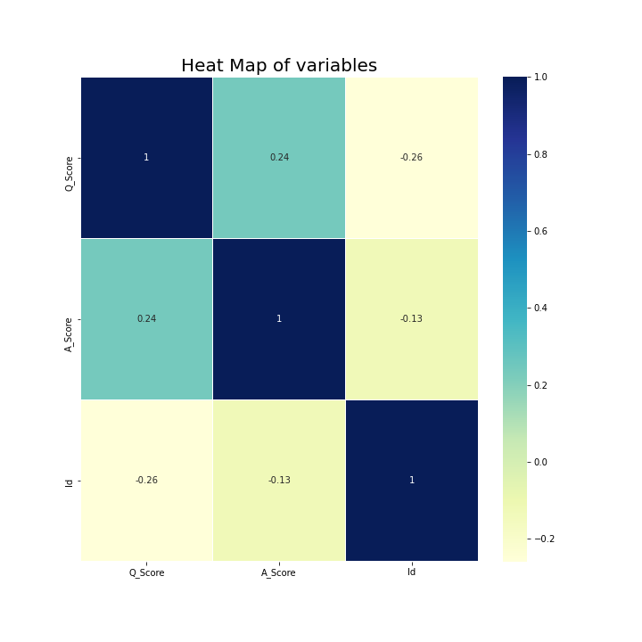
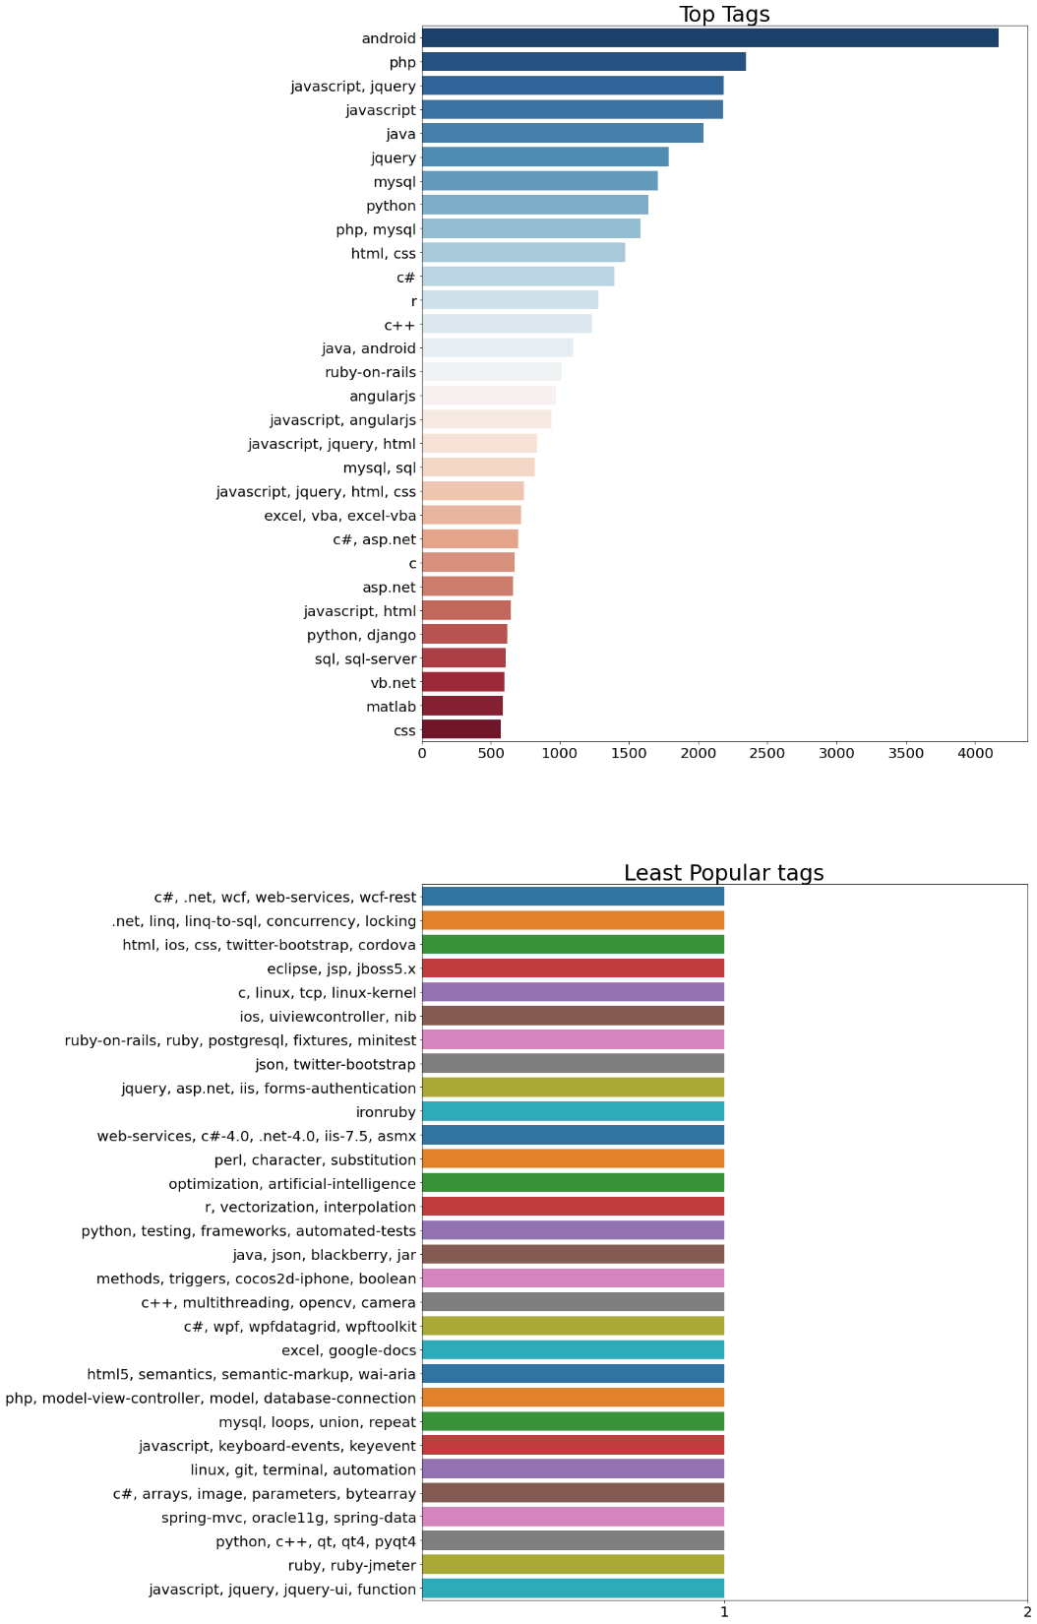



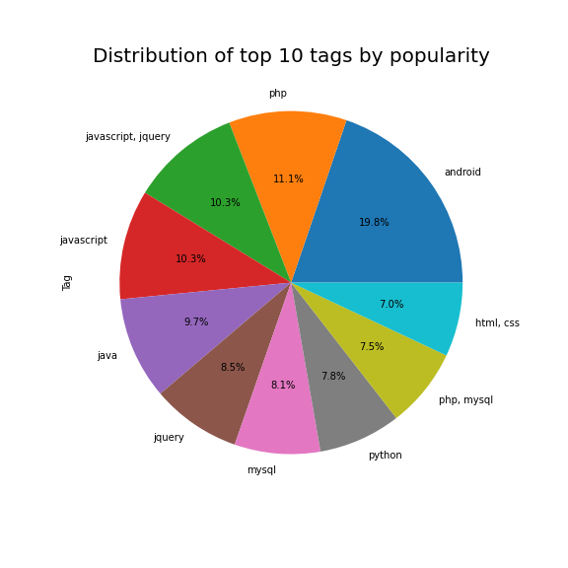
2. Data Exploration (EDA)
https://github.com/piyush-springboard/projects-and-assignments/blob/main/Capstone-3/Data%20Wrangling%20and%20Exploratory%20Data%20Analysis.ipynb
Android rules in terms of developer community support based on questions posted.
There is no strong correlation between question and answer scores.

Slide 7
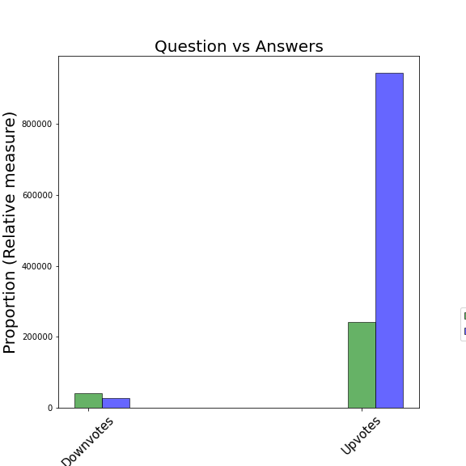
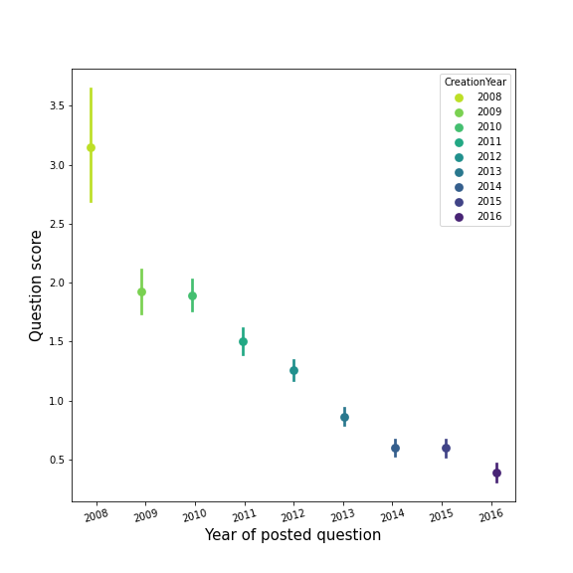
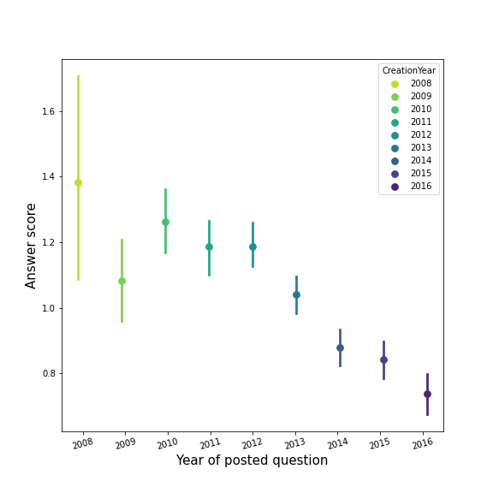
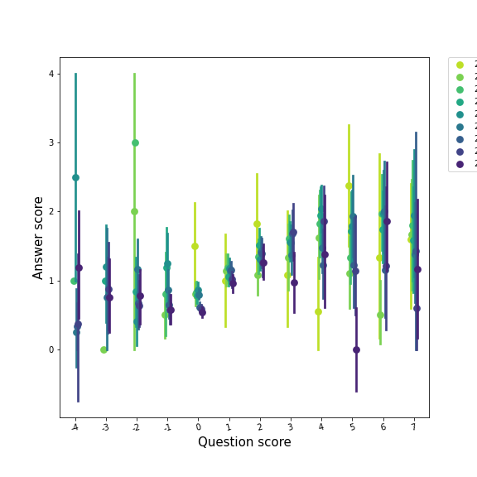
Average scores for both question and answers have reduced over time.
The reason could be due to a different scoring mechanism which could have possibly changed later OR the initial enthusiasm of yesteryears where developer community used to more actively upvote on questions and answers which eventually started reducing over time.
There is a higher % of downvotes to questions than to answers

Slide 8
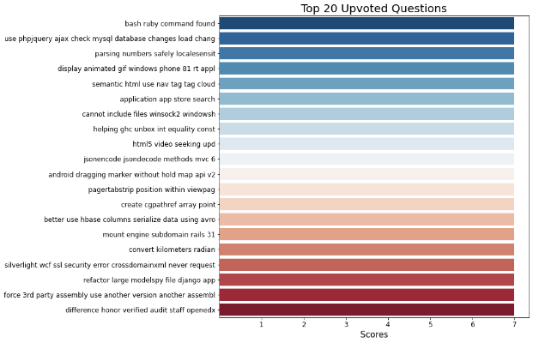

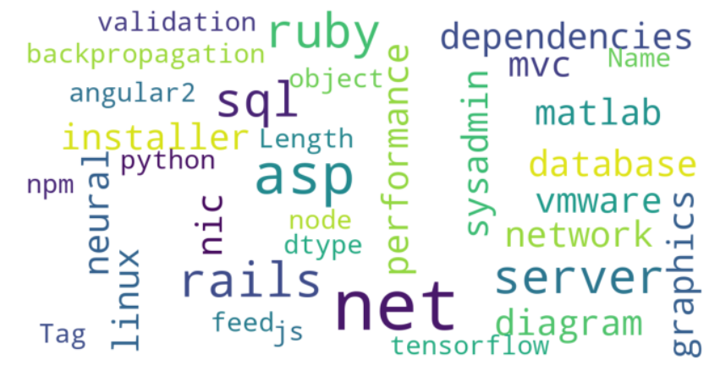
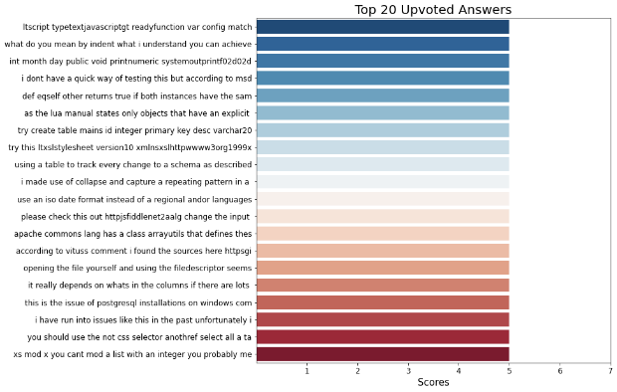
We are looking!!!
We are scouting top questions, tags, answers, etc.!!!
World cloud of tags

Slide 9
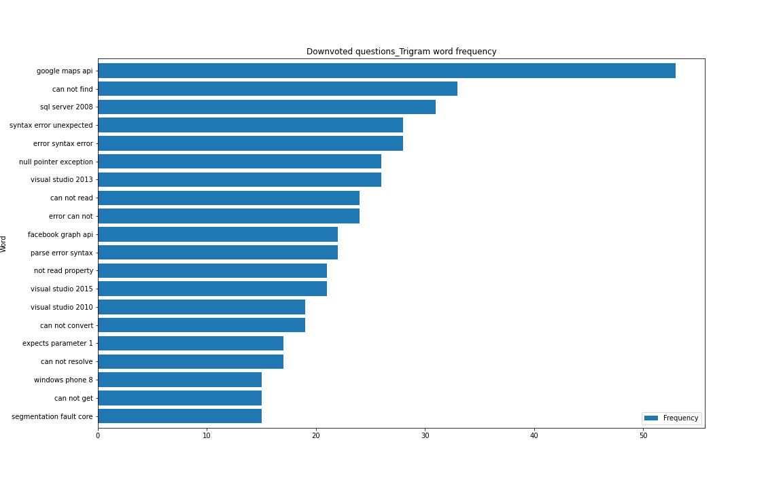

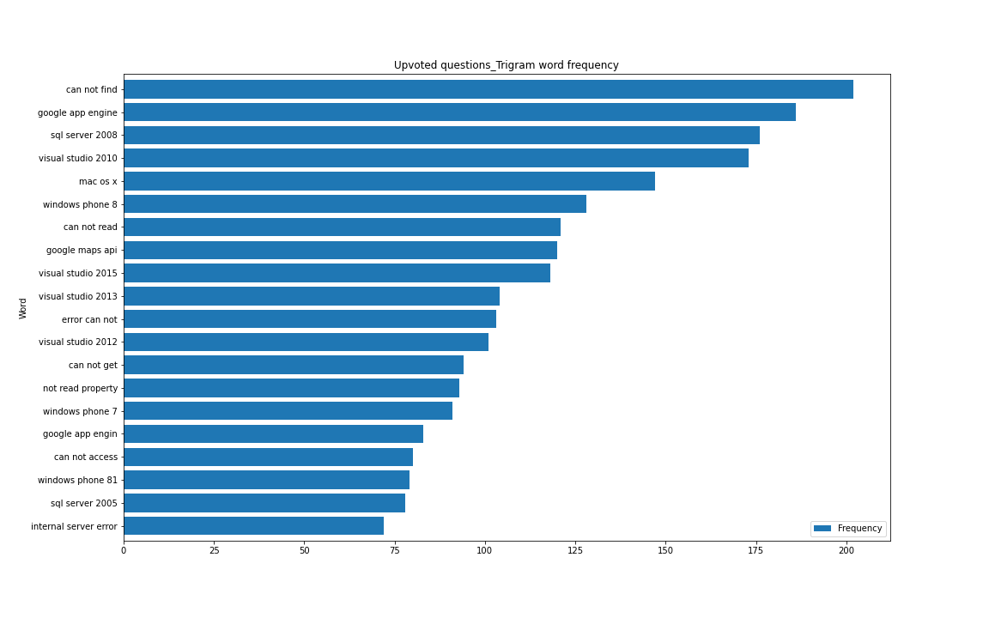
SQL server 2008 has very polarized opinions on developer community. Lets keep an eye on that..

Slide 10
3. Feature Engineering
https://github.com/piyush-springboard/projects-and-assignments/blob/main/Capstone-3/Data%20Wrangling%20and%20Exploratory%20Data%20Analysis.ipynb
Cleansed data
Combined dataset: 182K questions
Data pre-processing
Question Body
Top 10 Tags
Categorical variable 1
Dependent Variables
Independent Variables (question body’s unigram)
Categorical variable 2
Categorical variable 200
….
Top 5 tags present– 1 vs 0
5 columns
TFIDF vectorization
One Hot encoding
Scaling
Data (Training data development)
Training: ~1268K questions
Test: ~54K questions

Slide 11
4. Machine Learning Modeling
https://github.com/piyush-springboard/projects-and-assignments/blob/main/Capstone-3/Data%20Wrangling%20and%20Exploratory%20Data%20Analysis.ipynb
Type: Supervised Learning (Multi-label classification models)
Models applied
tree.DecisionTreeClassifier()
KNeighborsClassifier(),
MLPClassifier()
LogisticRegression(),
RandomForestClassifier()
GradientBoostingClassifier()
Dependent variable – ‘Tag1’, ‘Tag2’, ‘Tag3’, ‘Tag4’, ‘Tag5’ (Maximum 5 tags associated to a question) – 1 vs 0 (top 10 tag present vs absent)
Independent variables (predictors) – 200 categorical feature (after TFIDF vectorization)
70% Training data
Dataset size:
~1268K training dataset, ~54K test dataset
30% Test data
Need to decompose it into multiple independent binary classification problems (one per category) using “one-to-rest” strategy, where we will build multiple independent classifiers and, for an unseen instance, choose the class for which the confidence is maximized.

Slide 12

Modeling Evaluation metrics:
Hamming loss
Fraction of the wrong labels to the total number of labels
Jaccard index score
Number of correctly predicted labels divided by the union of predicted and true labels
DecisionTreeClassifier() Classifier (Clf: OneVsRestClassifier)
Jaccard score: 27.03508909647539
Hamming loss: 9.772123951954162
KNeighborsClassifier() Classifier (Clf: OneVsRestClassifier)
Jaccard score: 24.000334616028105
Hamming loss: 9.551344389833627
MLPClassifier() Classifier (Clf: OneVsRestClassifier)
Jaccard score: 24.49668524016757
Hamming loss: 9.758456645727652
LogisticRegression() Classifier (Clf: OneVsRestClassifier)
Jaccard score: 0.05601194921583271
Hamming loss: 8.44166425736589
RandomForestClassifier() Classifier (Clf: OneVsRestClassifier)
Jaccard score: 8.797956743832192
Hamming loss: 8.822246169211764
ExtraTreeClassifier() Classifier (Clf: OneVsRestClassifier)
Jaccard score: 27.546250834675362
Hamming loss: 9.696428102084266
MLPClassifier()
Vs.
ExtraTreeClassifier()

Slide 13

Hyperparameter Tuning:
In last slide,
MLPClassifier() and ExtraTreeClassifier() had best Jaccard score, but the latter trumped a tad bit
For both models, we will perform Hyperparameter tuning using Grid Search Cross validation
Cross validation (CV) for hyperparameter tuning
Three-fold CV
Using scikit-learn’s grid search method
Evaluation metrics: Average F1 score and Jaccard Score
MLPClassifier()
Training time is: 55.17 seconds
Prediction time is: 0.16 seconds
Jaccard score: 0.34
Hamming loss: 8.45
F1 score: 0.006
Precision score: 0.373
Accuracy: 0.577
ExtraTreeClassifier()
Training time is: 174.32 seconds
Prediction time is: 2.98 seconds
Jaccard score: 0.80
Hamming loss: 8.45
F1 score: 0.016
Precision score: 0.441
Accuracy: 0.577
ExtraTreeClassifier() model
ExtraTreeClassifier() model using optimal parameters and 70% of training data
Conclusion 1:
Accuracy for MLPClassifier() model based on GridSearchCV and hyperparameter tuning applied comes out to 0.576 which is a tad better than ExtraTreesClassifier(), however for this purpose since the Jaccard score is so high ~ 0.99 for ExtraTreeClassifier(), we will clearly choose that as the final model to see how well the scores are after applying the model on unseen dataset.

Slide 14
Score Comparison – Training (validation) vs Test data
Model fit and predict on validation data
Algorithm: ExtraTreeClassifier() model
Hyperparameter tuning using Grid Search Cross validation
Apply saved model to fit and predict on unseen test data
Load model
Unseen Test data: Scores
Save model for future prediction
Training time is: 174.32 seconds
Prediction time is: 2.98 seconds
Jaccard score: 0.80
Hamming loss: 8.45
F1 score: 0.016
Precision score: 0.441
Accuracy: 0.577
Training time is: 87.53 seconds
Prediction time is: 4.02 seconds
Jaccard score: 89.80
Hamming loss: 0.869
F1 score: 0.946
Precision score: 0.99
Accuracy: 0.957
Conclusion 2:
The prediction time on unseen test data went slightly up from 4.6 seconds to 6 seconds which is not a dealbreaker
There was a significant improvement in f1 score
Accuracy has improved drastically to 0.94.
Jaccard score has reduced a bit from 0.99 to 0.86, however it is still a great score

Slide 15
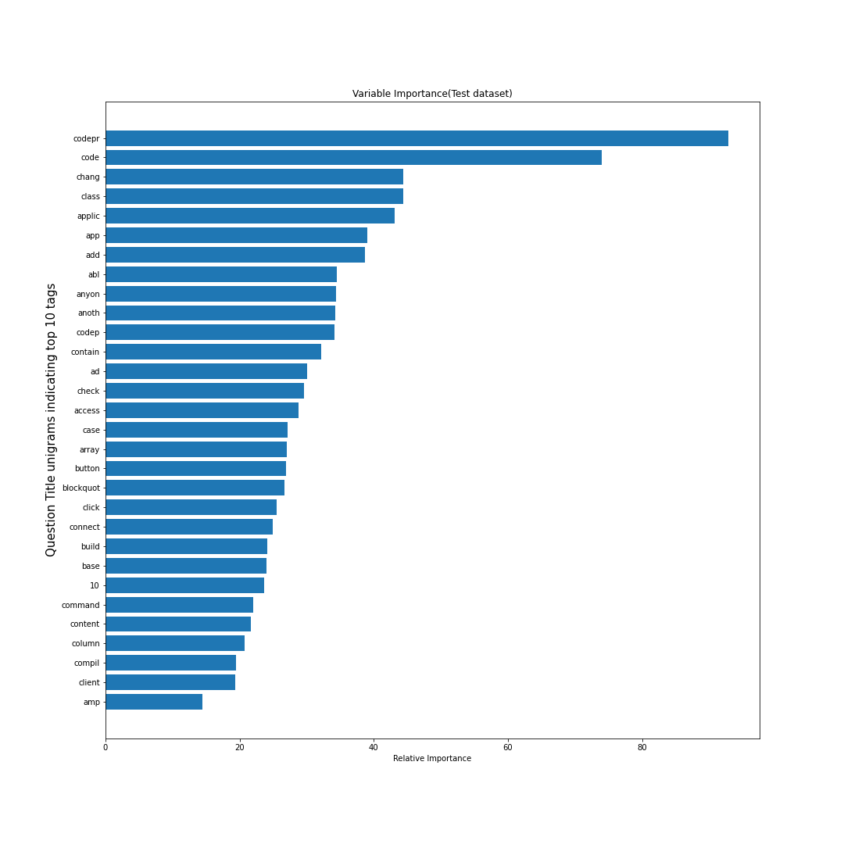



Top Features:
Confusion Matrix:
Training Validation dataset vs.
Test dataset
Most common question titles for top 10 tags
Unseen dataset
Conclusion 3:
There are a fewer number of misclassified top 10 tags across questions (%), i.e. false negatives

Slide 16
Future Research:
Apply a different training, test data split instead to further improve scores across different classification evaluation metrics.
Hyperparameter Tuning can be performed on MLPClassifier() model but limited scope of this project to only tuning ExtraTreeClassifier().
Perform hyperparameter tuning on additional parameters than just criterion, max_depth, max_features, n_estimators which could additionally improve the scores, especially the true positive score
Apply Cross Validation using GridSearchCV() across all models to be able to conclude on the best model.
Choose more than 200 max features aka categorical features for modeling step.
For this project scope, I chose 200 features due to CPU constraints causing overcommit memory issues.
Choosing 500-1000 max features would ensure modeling is performed on a dataset without getting rid of few important features that could have possibly been trimmed in this effort
Use word embeddings to analyze semantic and syntactic similarity, relation with other words for better classification and model results.
Target another business problem like predicting tags associated to questions that belong to unseen test dataset
Identify and tag questions to a specific topic which could be used as a basis for future tag recommendation when another developer posts a related question OR a question on a related topic.

